Slide 1

HUMANA
Case assignment – Mergers and Acquisitions (Aalto University School of Business)
Authors:
Ville-Einari Utriainen (439590), Miiro Nygrén (593575), Santeri Korhonen (487005), Jiaqi Yang (717733)

Slide 2

Contents
Executive summary
Humana as an investment opportunity
Health and social care industry overview
Discounted Cash Flow valuation and multiples
Synergies to Mehiläinen
Potential interlopers
Humana as a PTO target and recommendation

Slide 3
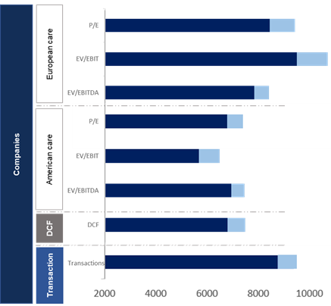
Executive summary
Buy Humana if you can get it for less than SEK 71 per share (~33 % premium).
Overview of Humana
A good cultural and strategic fit for Mehiläinen, except for the real estate strategy*
Humana is a leading Nordic care company providing services within individual and family care, personal assistance, elderly care and special service housing in accordance with LSS.
Revenue of SEK 7 467 million and operating profit of SEK 369 million in 2019.
Majority of Humana’s business is in Sweden (73 %) with strong focus on individual and family, and personal assistance (#1 in the Nordics)
The company has strong eldercare business in Finland with over 160 units and late double digit growth (over 20 % both 2018 and 2019).
A good cultural and strategic fit for Mehiläinen in terms of high quality, focus on digitalization and Finnish eldercare operations.
Finnish operations are going strong
Focus: eldercare and individual and family BAs
~4200 clients and 2 700 employees, 160 units
Strong growth: 15 new units opened, double digits organic growth in 2018-2019
Strong position in a personal care and individual and family
Leading player in personal assistance and individual and family sector
Market demand for personalization is growing
Market is expected grow annually 3-4 %
High brand and level of quality
High quality ratings (quality index of 92)
Strong focus on sustainability and responsibility with own operations that compliments Mehiläinen’s culture
Valuation with and without synergies
Strong focus on digitalization
Collaborating with technology and software companies to finding new solutions
Extensive adapter of motion sensors, alarms and other assisting technologies
Without synergies our analysis suggests a valuation in the range of SEK 5 100m-9 000m based on our DCF analysis and SEK 5 500m-7 500m based on multiples.
With EUR 5m yearly cost synergies the valuation gets up to SEK 5 600m-10 000m based on our DCF analysis and SEK
6 000m-8 000m based on multiples.
Recommendation:
Our recommendation is that Mehiläinen should buy Humana only if it can do so at what we consider a reasonable market price of SEK ~6 400 – 7 500 m based on our analysis Mehiläinen should offer a share price of SEK 50 with a maximum of SEK 71 per share (~33 % premium).
We recognize that the lower bid might not be the most enticing price for Humana shareholders and our recommendation is that Mehiläinen does not try to acquire Humana over the maximum share value, as we worry for the slowing growth and smaller than expected realized synergies.
However, one interesting additional recommendation is that we think that Mehiläinen should try to negotiate with Humana in order to acquire their businesses in Finland as we see them as the best matches for Mehiläinen in terms of synergies, integration and potential future growth.
Sources: Nordea market and company analysis (Humana), Humana annual reports (2015-2019), SCB
*refering to page 8

Slide 4
Contents
Executive summary
Humana as an investment opportunity
Health and social care industry overview
Discounted Cash Flow valuation and multiples
Synergies to Mehiläinen
Potential interlopers
Humana as a PTO target and recommendation

Slide 5
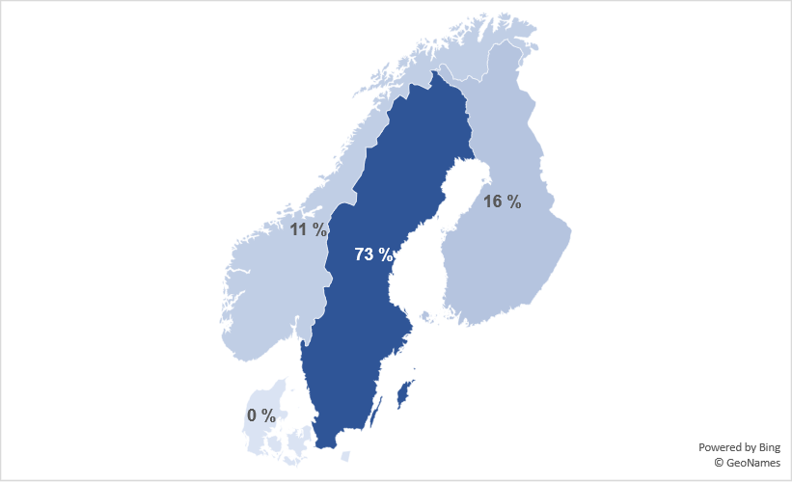
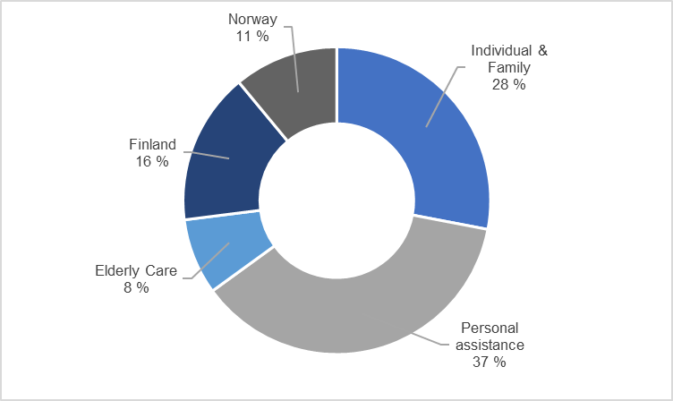
Humana
Elderly care business area in Sweden and Finland have grown strongly, other growth in Sweden has been modest
Humana’s operations and business areas
Humana’s strategy and financial targets
Key statistics of Humana
Majority of Humana’s business is in Sweden
Largest business area in Sweden is personal assistance with 37 %
“Everyone is entitled to a good life. Humana aims to be the care services provider of choice for customers, clients and buyers with high quality standards.”
Humana’s target for 2020 and onwards is a margin of 7 percent and annual organic growth of 5 percent, with a potential for additional annual growth of 2-3 % from acquisitions.
Debt not exceeding 4.5 times EBITDA with an exception in a case of an acquisition.
Revenue of SEK 7 467 million in 2019
Operating profit of SEK 369 million in 2019
Approximately 8 500 customers and clients (increase of 1 000 clients and customers from 2018)
Over 14 500 employees
Focus on own management – 93 % of operations, only 7 % are contracted
Strongest growing business area in 2018 and 2019 has been elderly care
Revenue has been growing at a CAGR of 5.5 %, analysts expect slowing down
In aggregate Humana’s business has been growing relatively strongly during years 2016-2019, however there are some highlights to be made.
Organic growth rate has been between -1.3 % to 3.4 % during years 2016-2019.
Growth in Sweden has been especially modest in 2018 and 2019, in Humana’s two biggest business areas: Individual and Family (organic growth in 2018: -1.3 % and in 2019 -4.0 %) and personal assistance (in 2018: 0.7 % and in 2019: 0.9 %).
Elderly care has been growing strongly with 33.0 % organic growth in 2018 and 23.3 % organic growth in 2019.
Humana has been growing in Finland through acquisitions and organic growth. In 2019, Humana’s Finnish business grew over 23 % due to the acquisition of Coronaria Hoiva (approx. EUR 53 million in revenues).
5.5 %
4.1 %
Sources: Nordea market and company analysis (Humana), Humana annual report 2018 and 2019, Humana website

Slide 6
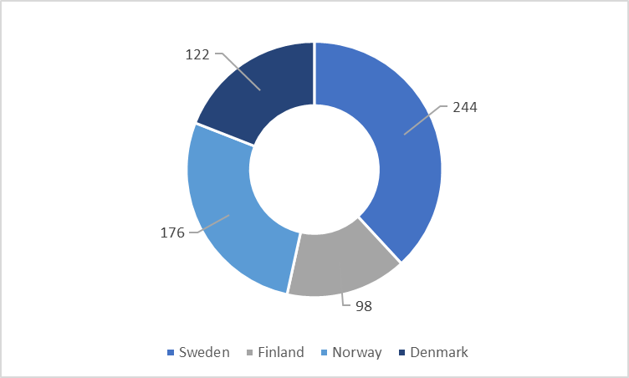
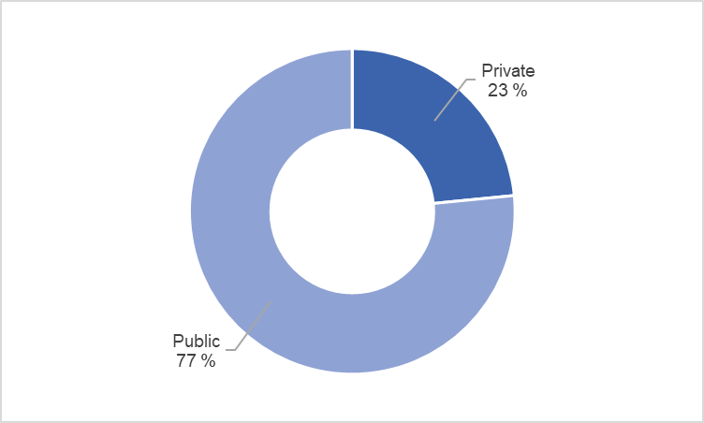



Nordic Health and Social Care Market is Massive
Humana operates in a large and growing market, which has a lot of future potential still left
Size of the Nordic care markets (in billions of SEK)
Key information about Swedish care market
Swedish care market is the largest with SEK 244 billion
The private market accounts for SEK 150 billion
Market size of over SEK 240 billion of which in aggregate 26 % is taken care of by private providers (compared to Finland with privatization of 40 %)
Sweden privatization: Individual and family (private ~32 %), personal assistance (private ~68 %) and eldercare (private ~16 %)
Swedish care market is expected to continue growing. The annual growth rate is expected to be around 3-4 %. The historical growth rate from 2006 to 2018 has been approximately 4 % (CAGR).
Privatization has strongly increased during 2015 and 2016. However, the trend has been slowing, last three years (2016-2018) privatization has grown at CAGR of 3 %.
Strongest growing sector has been elderly care, which is expected to grow. Sweden needs 560 new eldercare homes by 2026.
Swedish care market has grown at a CAGR of ~4% from 2006 onwards
Strongest competitors of Humana in Sweden per business area
In eldercare:
(over SEK 5 000m revenue from eldercare, 77 % of total revenue)
(over SEK 2 240m in revenue from eldercare, ~37 % of total revenue)
In individual and family:
(over SEK ~2 980 revenue from individual and family, 50 % of total revenue)
(over SEK 710m in revenue from individual and family, ~21 % of total revenue)
In personal assistance:
(over SEK 2 400m in revenue from personal assistance, 72 % of total revenue)
(over over SEK 3000m revenue from eldercare, ~48% of total revenue)
Sources: Nordea market and company analysis (Humana), Humana annual reports (2015-2019), SCB

Slide 7
Key Transformations Happening in the Health and Social Care Market
In addition to the growth, the need for innovative and cost-effective care services is accelerating
Key market trends that are shaping Humana’s operating environment
Humana’s response and role in the change
An aging population
In Sweden, the number of individuals over the age of 80 is expected to increase by 47 % over the next 10 years. More seniors means more people with age related illnesses, which will further increase the need for support services and elderly care.
Humana will be expanding elderly care operations, which will contribute to increasing needs. Today, up to one third of all new elderly care housing in Sweden is built by private providers.
Ageing health care and social care properties in Sweden
Many municipal properties in Sweden and Finland were built
during the period 1960-1990. Due to being more economic, new facilities will be built in the Nordics. Sweden will need around 560 new elderly care homes by 2026.
Humana builds both new elderly care homes and group homes for individuals with functional impairments according to LSS.
Increased mental illness
The rate of serious mental illness is on the increase. The highest growth is in depression and severe anxiety. The share of the population suffering from diminished psychological well-being has increased from 14 % to 17 % between 2006 and 2018.
Humana has one of the Nordic region's largest combined offerings of specialist expertise in care for mental illness and psychiatric diagnoses.
Greater demand for personalization and specialization
Person-centered care represents a transition from a model in
which the client is the passive recipient of a medical or social care determined by the care staff, to a model where decisions are made with the client.
This is creating a growing need for specialized care. Humana is the Nordic region’s largest provider of individual and family care services, enabling more people to get the help they personally need.
Public financing under pressure
Changed demographics in which increasingly fewer people will need to support an expanding number of people in need of care applies to the entire Nordic region. Municipalities and public institutions struggle for funding.
More innovative and significantly more cost-effective care will be required in the future. Humana provides high quality and cost-effective care, thereby saving enormous sums (SEK 1000m in 2018) for the national and municipal governments every year.
Digitalization
Increased digitalisation of the care sector in the future. Digital tools are powerful for working smarter and meeting the growing need for care services. Digital solutions can reduce recruiting needs and also strengthen the autonomy of residents and clients.
Humana collaborates with organizations such as technology and software companies, start-ups and academia. For several years, Humana has been using, for instance, modern alarm systems, keyless doors and motion sensor in elderly care homes.
Sources: Humana annual report 2018 and 2019, Humana website

Slide 8
Humana Key Investment Highlights
There are good strategic fit in digitalization and eldercare business, but Humana’s real estate strategy requires revision
Key attributes that make Humana an attractive and less attractive acquisition target
How these attributes correspond to Mehiläinen
Finnish operations are going strong
Focus: eldercare and individual and family BAs
~4200 clients and 2700 employees, 160 units
Strong growth: 15 new units opened, double digits organic growth in 2018-2019
Complementary to Hoiva Mehiläinen
Possibility to expand Mehiläinen’s eldercare market share
Is inline with company’s M&A strategy (complementarities, market share)
Strong position in a personal care and individual and family
Leading player in personal assistance and individual and family sector
Market demand for personalization is growing
Market is expected grow annually 3-4 %
Acquiring #1 player in personal care to diversify
An opportunity to diversify brand portfolio geographically and business area wise into a growing Swedish market
High brand and level of quality
High quality ratings (quality index of 92)
Strong focus on sustainability and responsibility with own operations and employee training
Good cultural fit through quality and sustainability POV
Humana is a good cultural fit to Mehiläinen’s high standard of quality (approx. 89 % satisfaction) and employee training
Strong focus on digitalization
Collaborating with technology and software companies to finding new solutions
Extensive adapter of motion sensors, alarms and other assisting technologies
Mehiläinen is a leading digital healthcare service provider in Finland
Potential synergies between Humana’s strong focus on digitalization and Mehiläinen’s knowledge on digital health care
Fast growing eldercare business in Sweden
Large growth potential for eldercare in Sweden
Humana’s quick growth in eldercare 2018 and in 2019 (33 % and 23 % respectively)
Leveraging Mehiläinen’s expertise in eldercare
Leveraging Hoiva Mehiläinen’s expertise in growing Humana’s eldercare faster in Sweden
Strong network of company management units
Own management is over 90 % (compared to competitors 67 % to 83 %)
Building and selling i.e. eldercare homes, and leasing them back is part of Humana’s strategy*
Real estate is not part of Mehiläinen’s core strategy
Even though Humana’s own management is a sustainability and responsibility advantage
Real estate building and selling does not fit to Mehiläinen’s lease and rent strategy
Sources: Humana annual report 2018 and 2019, Humana website, Mehiläinen corporate presentation, *News Cision (12/7/2019)

Slide 9
Contents
Executive summary
Humana as an investment opportunity
Health and social care industry overview
Discounted Cash Flow valuation and multiples
Synergies to Mehiläinen
Potential interlopers
Humana as a PTO target and recommendation

Slide 10
Discounted Cash Flow Analysis
Our more conservative DCF analysis suggests an Enterprise Value of SEK 6 396m
Information
Discounted Cash Flow analysis
The sales, EBITDA, depreciation, WACC and NWC/sales estimates on our case are straight from Nordea report of Humana for 2020E-2022E. We also hardcoded 2024E of sales so that CAGR of sales from 2019A-2024E is the 2.58 % that Nordea research suggests.
For EBITDA in 2023E-2024E we used average EBITDA margin from 2019A-2022E of 10.54 %. We also used average YoY change between 2019A-2022E to determine depreciation for 2023E-2024E. For NWC/sales Nordea research has a value of -4,0 % for 2020E-2025E so we just used this value to determine NWC.
For tax we used Sweden corporate tax rate of 21.4 % (2019 rate). We checked Nordea markets assumptions of 2020E-2024E against 2012A-2019A and they seem within reasonable range. For investments we take the Nordea reports 2012A-2019A average and use that as a best estimate for 2020E-2023E and we match depreciation for 2024E, as we believe this to be a better representation than the 0 predicted by Nordea report for 2020E-2022E.
For the terminal value we decided to with a conservative 1 % terminal growth rate. The terminal value for WACC 7 % represents large part of the total EV (70 % at terminal growth rate 1 %). This makes us question the validity of the assumptions used for the terminal value.
For the 5 EUR m yearly cost synergies we calculated using 21/11/2020 EUR/SEK rate of 10.22 to come up with the numbers shown right on sensitivity analysis and new EV for SEK 7042.7 m
(SEK m) | 2019A | 2020E | 2021E | 2022E | 2023E | 2024E
Sales | 7467.0 | 7771.0 | 7966.0 | 8185.0 | 8396.2 | 8481.3
% growth | 11.00% | 4.07 % | 2.51 % | 2.75 % | 2.58 % | 1.01 %
EBITDA | 699.0 | 810.0 | 871.0 | 938.0 | 885.3 | 894.3
% margin | 9.36% | 10.42 % | 10.93 % | 11.46 % | 10.54 % | 10.54 %
EBIT |  | 453.0 | 496.0 | 553.0 | 480.1 | 467.7
Taxes |  | -96.9 | -106.1 | -118.3 | -102.7 | -100.1
Depreciation |  | 357.0 | 375.0 | 385.0 | 405.3 | 426.6
Investments |  | -281.6 | -281.6 | -281.6 | -281.6 | -426.6
Changes in NWC |  | 12.2 | 7.8 | 8.8 | 8.4 | 3.4
Free Cash Flow |  | 443.6 | 491.1 | 546.8 | 509.5 | 371.0
PV of Free Cash Flow (WACC 7%) |  | 414.6 | 428.9 | 446.4 | 388.7 | 264.5
Sensitivity analysis based on different cost of capital and terminal growth rate (EV of Humana) and 5 EUR m synergy on right
Weighted cost of capital
Weighted cost of capital
SEK m | 6.00 % | 6.50 % | 7.00 % | 7.50 % | 8.00 %
0 % | 6563.8 | 6109.2 | 5722.1 | 5388.9 | 5099.4
1 % | 7543.4 | 6915.9 | 6396.0 | 5958.7 | 5586.4
2 % | 9012.8 | 8081.1 | 7339.5 | 6735.8 | 6235.7
SEK m | 6.00 % | 6.50 % | 7.00 % | 7.50 % | 8.00 %
0 % | 7228.7 | 6724.9 | 6295.8 | 5926.6 | 5605.8
1 % | 8314.4 | 7618.9 | 7042.7 | 6558.1 | 6145.5
2 % | 9942.8 | 8910.3 | 8088.3 | 7419.4 | 6865.1
Terminal growth rate (g)
Terminal growth rate (g)
Source: Nordea research

Slide 11
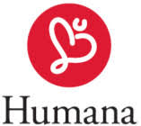
Company trading multiples analysis
Our analysis suggests that Humana's EV/EBITDA and P/E are close to the US companies' multiples and EV/EBIT is in between US and North European companies' multiples
Comments
EV/EBITDA
EV/EBIT
P/E
We consider healthcare companies that are operating also in the field of elderly care and home care to match the companies with Humana's operations. We are excluding companies focusing on pharmaceutics and health technology to offer a more similar market positioning with Humana.
About geographical areas, we consider North Europe (including France) instead of the Nordics because in Norway and Denmark the care industry is mostly operated by the public sector.
We also consider US companies to offer multiples from another highly competitive western market area. Considering the US companies, we are excluding the biggest players with 100bn+ market cap to provide a more similar market positioning with Humana in the Nordics.
According to Carlsquare 2020 snapshot there is no apparent valuation differences between US and European sector peers.
European care companies
Median: 10.5x
Median: 24.1x
Median: 22.5x
EV/EBITDA
EV/EBIT
P/E
American care companies
Median: 9.4x
Median: 14.6x
Median: 14.3x
EV/EBITDA: 9.5x
EV/EBIT: 18.0x
P/E: 15.7x
Sources: Companies' Annual Reports, Bakertilly website, Carlsquare website
Notes:
https://prismic-io.s3.amazonaws.com/baker-tilly-www/b348f669-4cd0-45b1-a2c5-00b695a39e25_Healthcare+MA+update_Q2+2019.pdf
Comparable companies:
UnitedHealth Group Incorporated
Cigna Corporation
Anthem Inc
Centene Corporation
WellCare Health Plans Inc
Molina Healthcare Inc
Magellan Health Inc
Triple-S Management Corporation

Slide 12
Precedented transactions
Precedent transaction imply a median EV/EBITDA multiple of 12.5x
Date | Country | Target | Case description | Acquirer | EV ($m) | EV/EBITDA
4.11.2019 | US | VIP Health Care Services Inc | Offers home care services | Nova Leap Health Corp. | 0.4 | N/A
1.10.2019 | US | RoseRock Healthcare | Provides hospice care services to patients | Addus HealthCare Inc. | 130,0 | N/A
3.8.2019 | US | Alliance Home Care/House Calls of New Mexico/Foremost Home Care | Offers home healthcare services | Addus HomeCare Corporation | 24 | N/A
1.7.2019 | US | Alacare Home Health & Hospice | Provides hospice care and home care services to patients | Amedisys Inc. | 217,5 | N/A
3.6.2019 | US | VIP Health Care Services Inc | Offers home care services | Addus HomeCare Corporation | 28 | N/A
1.4.2019 | US | RoseRock Healthcare | Provides hospice care services to patients | Amedisys Inc. | 17,5 | N/A
22.3.2019 | US | Northwest Buffalo Community Health Care Center Inc | Provides residential health care services | EN Operations Acquisitions LLC | 0,5 | N/A
5.3.2019 | US | BrightSpring Health Service | Provides home and community-based services | PharMercia Corporation | 1320,0 | N/A
Date | Country | Target | Case description | Acquirer | EV ($m) | EV/EBITDA
8.3.2019 | US | Civitas Solutions Inc | Provides home and community-based services to must-serve individuals | Centerbridge Partners L.P | 1384,3 | 7.9
2.1.2019 | US | Compassionate Care Hospice Group Inc | Provides hospice care services to patients | Amedisys Hospice L.L.C. | 340 | 12.6
21.12.2017 | UK | The Regard Partnership | Specialist care provider for mental health and disabilities | AMP Capital Partners | €405m | 14.5
4.12.2017 | GER | Alloheim Senioren-Residenzen | Private health care home operator | Nordic Capital | €1070m | 12.5
Median: 12.5x
Mean: 11.9x
Sources: Bakertilly website, Clearwater International website
Notes:
https://www.carlsquare.com/wp-content/uploads/European-Life-Sciences-Market-Snapshot-2020-final.pdf additional data (though not as nice of format and not as much information) https://www.clearwaterinternational.com/assets/pdfs/Healthcare-Report-French.pdf

Slide 13
Valuation summary
Paying SEK 50.49 per share (4.7 % discount) makes sense from valuation perspective
Overview
Implied enterprise values relative to the market valuation
According to the financial statements of Humana and current market value of shares, the market assumes Humana to be worth approximately SEK 6 500m (given the 31.12.2019 liabilities, cash and average shares outstanding and current share price of SEK 53 on 30.10.2020). For P/E values we get enterprise value by adding the net interest bearing debt of Humana SEK 3 712m to the values.
The implied enterprise value ranges on the football field represent the values around the median value.
Approximate market value of Humana (Oct 30 2020)
Current market value
Market entity value (2019 balance sheet) | SEK ~6 500m
Share price (30.10.2020) | SEK 53.0
European care
American care
Implied share prices (SEK)
Companies
Transaction
DCF
DCF (WACC 7 %, terminal growth 1 %) | 50.49
EV/EBITDA 2019 (European median) | 68.77
EV/EBITDA 2019 (American median) | 54.30
Comments
DCF range is +- 1pp of the Nordea Research 7,00 % WACC. This is good metric for Humana as it uses actual cash flows in the same company.
The multiples of American and European companies are relatively close to each others based on the multiples valuations as well.
However, the European multiples seem to give Humana a little higher value than the American counterparts.
Most of the transactions are from the Anglo-Saxon market, which may not be the best reference to the Nordic care market
Sources: Humana annual report 2018 and 2019, Humana website,Companies' Annual Reports

Slide 14
Contents
Executive summary
Humana as an investment opportunity
Health and social care industry overview
Discounted Cash Flow valuation and multiples
Synergies to Mehiläinen
Potential interlopers
Humana as a PTO target and recommendation

Slide 15
Potential sources of synergies
Reasonable cost and financial synergies could be expected based on our analysis
Revenue
Cost synergies
Financing
Bargaining power to customers:
It is possible to expect that Mehilänen will have a higher bargaining power with customers in the market merging. It diminishes the risk and impact when changing the price on high quality and high degree of specialization and individualized care. Thus, it is easier to increase revenue by raising the price in this sense. However, it might also be a case that in some segments of service, the price is not fully determined by the company itself but is restricted in a certain price range by the government.
Better service provide:
Humana and Mehilänen provide high quality and cost-effective healthcare, so they have similar technique and goals on providing services. Therefore, by exchanging and communicating the ideas, it can be expected to increase the quality of service and fulfillment of the customers, leading to increase the quantity of sales.
Strengthen geographical presence:
Considering that Humana is one of the largest providers of outpatient care and residential care homes in Finland, the revenue can increase significant in near future because of the increasing trend of needs on residential care homes service. Besides,Humana has over 73% of revenue is generated from Sweden. Therefore, it also helps Mehilänen gain a bigger market share in Sweden and get a profitable growth, leading to serve a broader market.
Personnel costs:
Having sufficient qualified labor and ensuring to delivery the care that its citizens need and expect are critical for success in the welfare system of the future. Both Humana and Mehilänen are good at attracting talented employees. Ensuring access to skilled labor can reduce the cost of training.
Problems identify cost:
There could be a synergies on using customer data when serving for a larger group of customers. For example, managerial problems, customer service problems can be more easily shown and improved.
Purchasing cost:
Mehilänen is likely to have a larger barging power with the suppliers and get a better price on medicine, drugs and equipment.
Management cost
After merging, the management costs can be cut.
Supply Chain advancement:
They may have a better plan for logistics and inventory management about the drugs and equipment.
Research and development cost:
The research and development will be more efficient, considering that it will get the smartest people to work together.
Debt capacity:
If two leading companies merge, the debt capacity may increase, and the interest rate is expected to decrease. However, based on the balance sheet, Mehilänen doesn’t have enough cash, so it has to lever up in order to purchase the Humana company. In this case, the whole company is riskier, thus the interest rate would increase.
Return on equity:
Return on equity can be expected to increase, because there is a larger room for Mehilänen to use more financial leverage.
Cost of equity and debt:
Even thought the service provided in Humana is similar with Mehilänen, which means that the investment is not well diversified, as Humana is located in Sweden, Mehilänen can avoid the risk of being too big and being blocked by the competition law. However, on the other hand, Mehilänen must bear the risk of currency exchange. Therefore, the cost of equity and debt can be affected by a lot of factors.
Overall, if Humana would become a part of Mehilänen, it is possible to gain revenue synergies as market position mainly in Finland and Sweden is strengthened. Reasonable cost synergies and financing synergies can be expected.
Sources: Humana annual reports (2018-2019)

Slide 16
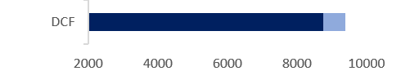
Synergy analysis
Considering EUR 5m in synergies helps to push the offer to SEK 62,68 (premium ~18 %)
Comments
Valuation (EV in SEK)
Implied share price (SEK) (With synergy/without synergy)
Annual cost synergies of EUR
5m increase the Enterprise Value
on average ~22,5 % of all valuation
metrics.
As shown earlier without synergies Humana is not a very attractive acquisition target as the current market price of Humana is relatively close to the more conservative DCF valuation of Humana.
Annual synergies of EUR 5m increase the attractiveness of Humana as a PTO target. The potential synergies makes it possible to offer a larger premium on Humana, which reduces the risk of potential financial interlopers.
78.8 / 68.6
120.7 / 97.6
96.2 / 79.2
62.2 / 53.2
45.2 / 31.2
61.1 / 50.3
62.7 / 50.5
106.6 / 94.6
European care
Companies
American care
DCF
Transaction
Transactions
Sources: Humana annual report 2018 and 2019, Humana website

Slide 17
Contents
Executive summary
Humana as an investment opportunity
Health and social care industry overview
Discounted Cash Flow valuation and multiples
Synergies to Mehiläinen
Potential interlopers
Humana as a PTO target and recommendation

Slide 18
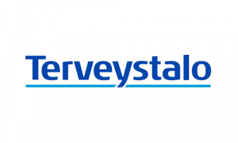
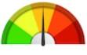

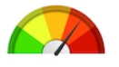

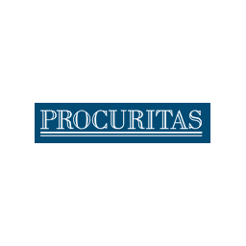
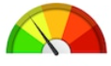






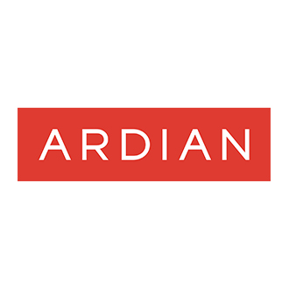
Potential interlopers
Low risk of financial bidders but some risk for strategic bidders
Potential interloper institutions and firms
Comments
Risk
Strategic bidders
Nordic
Only few companies in the Nordics that have the scale to bid for Humana
Attendo and Ambea have businesses that would most likely be complementarities to Humana
International
Some European companies have the scale to bid for Humana
Korian entered the Dutch markets in 2019 and has been actively developing its operations there. Koninklijke Philips N.V has also been active in acquiring elderly care operations
Financial bidders
Nordic
These are Nordic investment companies that have been most active in acquiring firms operating in healthcare industry.
International
These companies have a history of acquisitions in European healthcare market.
However, most of these companies are venture capital companies and they might not be interested in making a public tender offer.
The most risk of interloping is linked to strategic bidders. Due to current market value of Humana and implied values derived from multiples and DCF model, we believe that financial bidders are not interested in bidding for Humana. However, the strategic bidders might be interested in bidding for the company with the hopes of reaping some synergy benefits in the process.
Sources: Humana annual report 2018 and 2019, Humana website, company websites

Slide 19
Contents
Executive summary
Humana as an investment opportunity
Health and social care industry overview
Discounted Cash Flow valuation and multiples
Synergies to Mehiläinen
Potential interlopers
Humana as a PTO target and recommendation

Slide 20
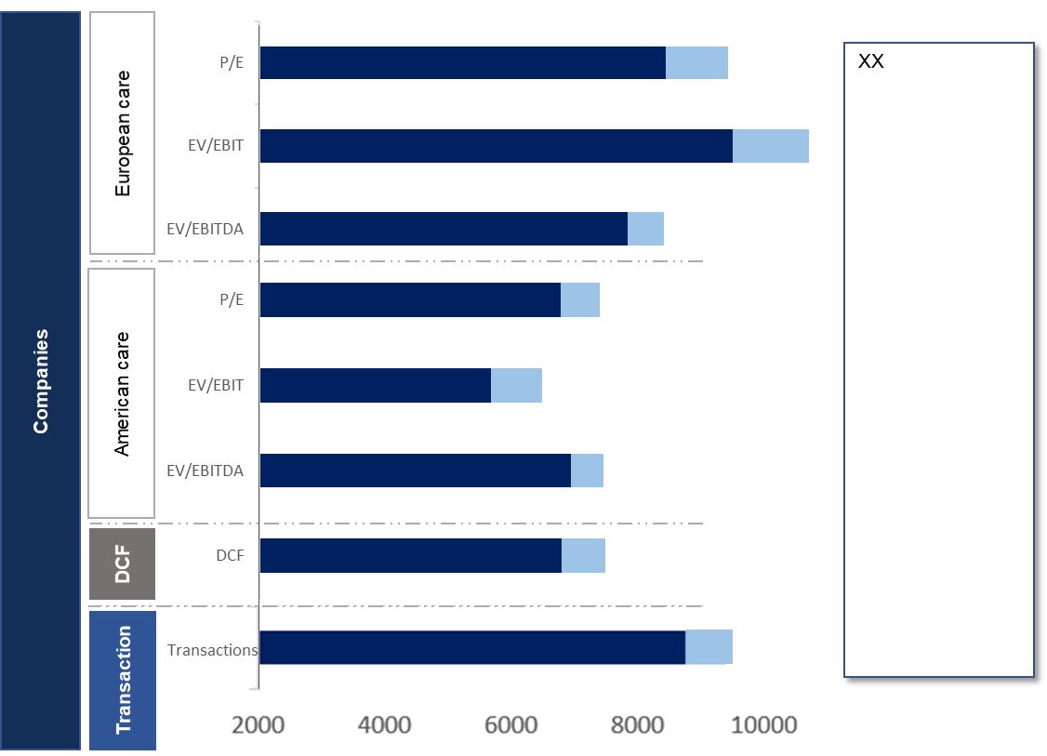
Humana as a PTO Target - Summary
A relatively attractive opportunity to go after if you can get it for the right price
Shareholders: get the top 5 (52 %) on board before launching the PTO
A good cultural and strategic fit for Mehiläinen
Top 3 shareholders: Impilo Care AB (20.2 %), Air Syndication SCA (11.6 %) and UBS AG London Branch (9.7 %)
Shareholder base is quite concen-trated, need to attract and listen to the majority owners.
To mitigate interloper risk, we recommend getting as many major owners on board as possible (i.e. top 5) before launching the offer
Finnish operations are going strong
Focus: eldercare and individual and family BAs
~4 200 clients and 2 700 employees, 160 units
Strong growth: 15 new units opened, double digits organic growth in 2018-2019
Strong position in a personal care and individual and family
Leading player in personal assistance and individual and family sector
Market demand for personalization is growing
Market is expected grow annually 3-4 %
High brand and level of quality
High quality ratings (quality index of 92)
Strong focus on sustainability and responsibility with own operations that compliments Mehiläinen’s culture
Valuation of Humana with and without synergies
Strong focus on digitalization
Collaborating with technology and software companies to finding new solutions
Extensive adapter of motion sensors, alarms and other assisting technologies
Our analysis suggests that the valuation of Humana is roughly somewhere in between SEK 5 100m to 10 000m based on the DCF analysis, accounting for the EUR 5m yearly cost synergies in the higher end. We also recognize that the higher end of that spectrum is based on highly optimistic assumptions and should not be taken at face value.
Based on our multiples analysis the fair valuation of Humana is something in between SEK 5 500m to 7 500m.
IF going after Humana acquisition, watch for Nordic strategic bidders
Strategic bidders
Humana’s strong position in Sweden is attractive to other Swedish and Nordic operators.
Also international players maybe interested in expansion to the Nordic system that experiencing increasing shares of privatization.
Financial bidders
Due to the current market value of Humana, and little upside implied by multiples and DCF, financial bidders are most likely to pass Humana.
Sources: Humana annual report 2018 and 2019, Humana website

Slide 21

Case assignment – Mergers and Acquisitions (Aalto University School of Business)

